Slide 1
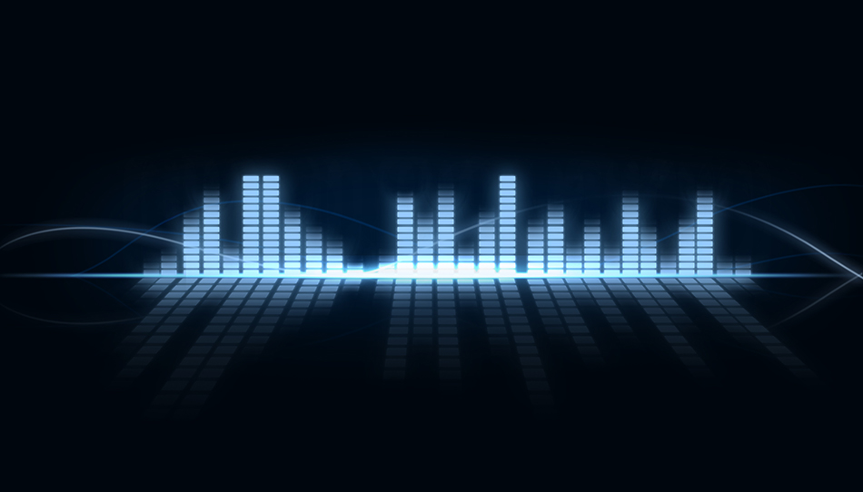
MUSIC EQUALIZER
by
Jayakrishna Narra
Shreyas Joshi

Slide 2
Contents
What is EQ
Types
Implementation of EQ
frequency response
Presenting the 3 band EQ

Slide 3
What is EQ
It is a filter that allows you to adjust the amplitude of particular frequency or a set of frequencies
In its most used form it allows you to enhance the bass and treble of the signal
Equalizers can be used to model an audio for certain environments
Applications:
Mobile phones, portable radios, music concerts, etc

Slide 4
Types of EQ
Parametric EQ
Typically provides control over the gain for each frequency band and control over the center frequency, fc
Graphical EQ
Typically contains bank of sliders to control the gain of different frequency bands

Slide 5
Implementation of EQ
Contains number of Shelving filters designed to target different bands of frequencies
Low shelf or low shelving filter –
parameters: cut of frequency, gain
Peak filter
Parameters: Q factor, gain
High shelf or high shelving filter
Parameters: Cut off frequency, gain
Tools and libraries used: Python Tkinter for GUI, threading, Pyaudio, scipy, wave, MATLAB

Slide 6
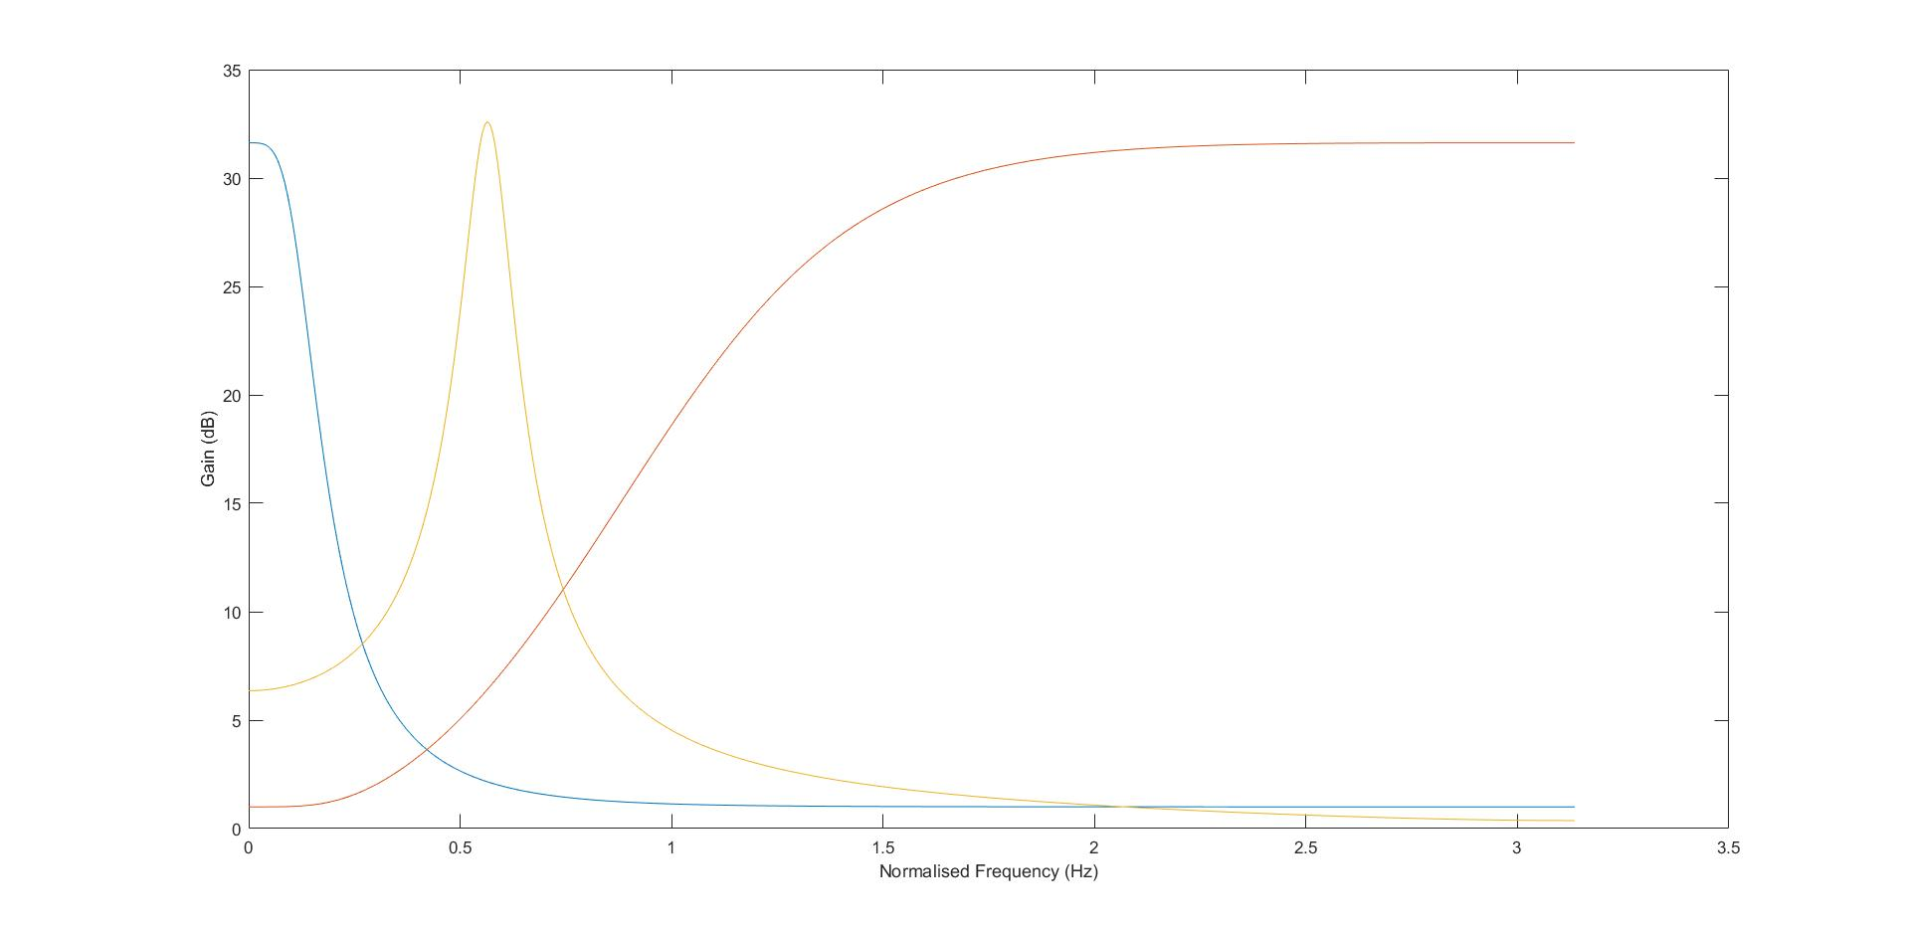
Frequency response of 3 band EQ

Slide 7
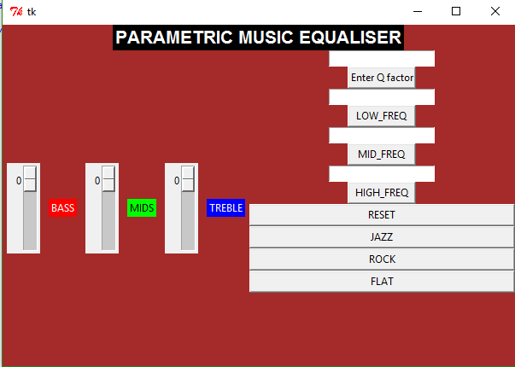
Presenting the 3 band EQ

